Slide 1

Personal Recipe Generator
CSI 2300 Final Project
By Austin Toma and Sebastian Hakim

Slide 2
Problem Statement
It can be difficult for people (especially those with dietary restrictions/allergies) to find a good meal. Our project can be a solution to many with this problem.

Slide 3
What our project can accomplish
Provides recipes based on user preferences
Takes allergies/dietary restrictions into consideration
Lists the ingredients of each recipe provided
Can also be filtered to produce food options for all types of meals throughout the day(breakfast, lunch, dinner, snacks)

Slide 4
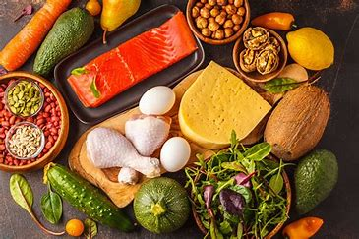
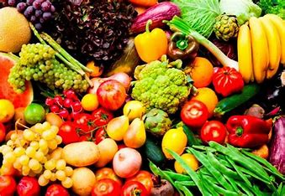

Slide 5
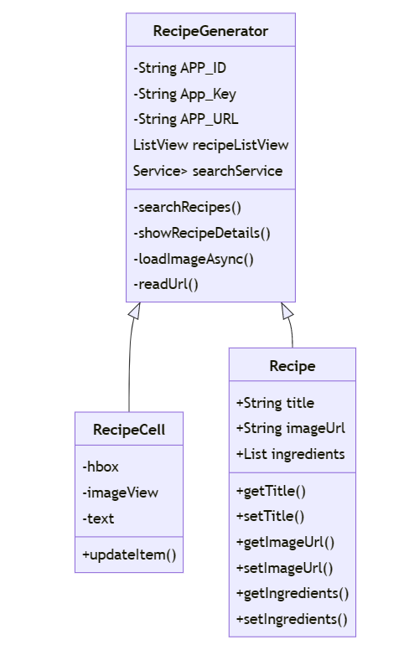
UML class diagram

Slide 6
How our project is helpful
“Recipe Generator” that provides meal options and ingredients needed to make the meal
Creative and challenging
Useful for many people with dietary restrictions and allergies

Slide 7
More Information
Accesses an API to generate different recipes, ingredients(Edamam.com)
Each recipe also includes a picture associated with it
Search bar at the top for more versatility

Slide 8
Estimation of work
Sebastian Hakim - Java FX UI, UML
Austin Toma - Installing and accessing API
Worked together on code, Read me, and User Manual

